Slide 1
Sentiment Analysis
Sentiment Lexicons

Slide 2
The General Inquirer
Philip J. Stone, Dexter C Dunphy, Marshall S. Smith, Daniel M. Ogilvie. 1966. The General Inquirer: A Computer Approach to Content Analysis. MIT Press
Home page: http://www.wjh.harvard.edu/~inquirer
List of Categories: http://www.wjh.harvard.edu/~inquirer/homecat.htm
Spreadsheet: http://www.wjh.harvard.edu/~inquirer/inquirerbasic.xls
Categories:
Positiv (1915 words) and Negativ (2291 words)
Strong vs Weak, Active vs Passive, Overstated versus Understated
Pleasure, Pain, Virtue, Vice, Motivation, Cognitive Orientation, etc
Free for Research Use

Slide 3
LIWC (Linguistic Inquiry and Word Count)
Pennebaker, J.W., Booth, R.J., & Francis, M.E. (2007). Linguistic Inquiry and Word Count: LIWC 2007. Austin, TX
Home page: http://www.liwc.net/
2300 words, >70 classes
Affective Processes
negative emotion (bad, weird, hate, problem, tough)
positive emotion (love, nice, sweet)
Cognitive Processes
Tentative (maybe, perhaps, guess), Inhibition (block, constraint)
Pronouns, Negation (no, never), Quantifiers (few, many)
$30 or $90 fee

Slide 4
MPQA Subjectivity Cues Lexicon
Theresa Wilson, Janyce Wiebe, and Paul Hoffmann (2005). Recognizing Contextual Polarity in
Phrase-Level Sentiment Analysis. Proc. of HLT-EMNLP-2005.
Riloff and Wiebe (2003). Learning extraction patterns for subjective expressions. EMNLP-2003.
Home page: http://www.cs.pitt.edu/mpqa/subj_lexicon.html
6885 words from 8221 lemmas
2718 positive
4912 negative
Each word annotated for intensity (strong, weak)
GNU GPL

Slide 5
Bing Liu Opinion Lexicon
Minqing Hu and Bing Liu. Mining and Summarizing Customer Reviews. ACM SIGKDD-2004.
Bing Liu's Page on Opinion Mining
http://www.cs.uic.edu/~liub/FBS/opinion-lexicon-English.rar
6786 words
2006 positive
4783 negative

Slide 6
SentiWordNet
Stefano Baccianella, Andrea Esuli, and Fabrizio Sebastiani. 2010 SENTIWORDNET 3.0: An Enhanced Lexical Resource for Sentiment Analysis and Opinion Mining. LREC-2010
Home page: http://sentiwordnet.isti.cnr.it/
All WordNet synsets automatically annotated for degrees of positivity, negativity, and neutrality/objectiveness
[estimable(J,3)] “may be computed or estimated”
Pos 0 Neg 0 Obj 1
[estimable(J,1)] “deserving of respect or high regard”
Pos .75 Neg 0 Obj .25

Slide 7
Disagreements between polarity lexicons
Christopher Potts, Sentiment Tutorial, 2011
 | Opinion Lexicon | General Inquirer | SentiWordNet | LIWC
MPQA | 33/5402 (0.6%) | 49/2867 (2%) | 1127/4214 (27%) | 12/363 (3%)
Opinion Lexicon |  | 32/2411 (1%) | 1004/3994 (25%) | 9/403 (2%)
General Inquirer |  |  | 520/2306 (23%) | 1/204 (0.5%)
SentiWordNet |  |  |  | 174/694 (25%)
LIWC

Slide 8
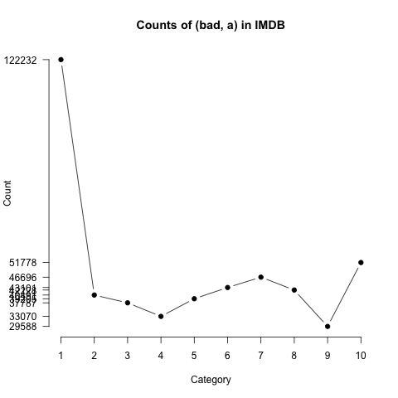
Analyzing the polarity of each word in IMDB
Potts, Christopher. 2011. On the negativity of negation. SALT 20, 636-659.
How likely is each word to appear in each sentiment class?
Count(“bad”) in 1-star, 2-star, 3-star, etc.
But can’t use raw counts:
Instead, likelihood:
Make them comparable between words
Scaled likelihood:
Notes:
Thanks to Chris Potts for permission to use figure

Slide 9
Analyzing the polarity of each word in IMDB
Potts, Christopher. 2011. On the negativity of negation. SALT 20, 636-659.
Scaled likelihood
P(w|c)/P(w)
Scaled likelihood
P(w|c)/P(w)
Notes:
Thanks to Chris Potts for permission to use figures

Slide 10
Other sentiment feature: Logical negation
Potts, Christopher. 2011. On the negativity of negation. SALT 20, 636-659.
Is logical negation (no, not) associated with negative sentiment?
Potts experiment:
Count negation (not, n’t, no, never) in online reviews
Regress against the review rating

Slide 11
Potts 2011 Results: More negation in negative sentiment
a
Scaled likelihood
P(w|c)/P(w)
Notes:
Thanks to Chris Potts for permission to use figures

Slide 12
Sentiment Analysis
Sentiment Lexicons

